Slide 1
Developing Flexible and Maintainable Course Material
David Joyner

Slide 2
Script Lesson
Visualize Lesson
Traditional MOOC Development Process
Variations:
Script + visualize together
Add review and re-record phases
Script entire course first
Record Lesson
Edit
Lesson
Insert Lesson
Notes:
Traditional Model:
Script -> Visualize -> Record -> Edit -> Provide
Variations:
Script entire course before recording
Script+visualize simultaneously
Review/re-record phases
Problems:
Requires lessons to be filmed in single sittings (consistency, cohesion, etc.)
Record an entire lesson, then discover a problem (confusing, incorrect, new information) halfway through
Breaking flow
Visual consistency
(Case: Mark’s class)
Facts about HCI:
518 individual videos
~2.5 minutes each
~16 hours total material
Filmed in four locations and :
Headshot studio (3)
Tablet studio (2)
David’s house (12 – living room, kitchen, cars, foyer, etc.)
Udacity office (2)
Headshot: 43%
Tablet: 26%
On-Location: 31%
Rapidly interspersed: (show chart of one lesson)
Survey Results
Guidelines:
Script everything first
Make every video individually complete
Short videos

Slide 3
Limits Recording Flexibility
Lessons are recorded in a single sitting
Future recording plans unknown during current recording
Traditional MOOC Development Process
Limits Video Maintainability
Retaining visual consistency
Retaining narrative cohesion
Maintaining cross-dependencies
Notes:
Movie analogy:

Slide 4
Case Study:
CS6750: Human-Computer Interaction
Runtime:
518 individual videos
16.2 hours of total video material
~1.8 minutes per video
Filming:
4 locations
19 camera set-ups

Slide 5
Case Study:
CS6750: Human-Computer Interaction
43% Headshots
26% Screencapture
31% On-Location

Slide 6
Case Study:
CS6750: Human-Computer Interaction
Video | Location |  | Video | Location
2.2.1.1 | Headshot Studio |  | 2.2.12.3 | David’s House (Car)
2.2.2.1 | Tablet Studio |  | 2.2.13.1 | David’s House (Car)
2.2.3.1 | Tablet Studio |  | 2.2.13.2 | Exercise
2.2.4.1 | David’s House (Kitchen) |  | 2.2.13.3 | David’s House (Car)
2.2.5.1 | Headshot Studio |  | 2.2.14.1 | Headshot Studio
2.2.6.1 | Tablet Studio |  | 2.2.14.2 | Udacity Office
2.2.7.1 | David’s House (Thermostat) |  | 2.2.15.1 | Headshot Studio
2.2.8.1 | Headshot Studio |  | 2.2.16.1 | David's House (Breakfast Room)
2.2.9.1 | Headshot Studio (Morgan) |  | 2.2.16.2 | Exercise
2.2.10.1 | David’s House (Basement) |  | 2.2.16.3 | David's House (Breakfast Room)
2.2.10.2 | Exercise |  | 2.2.17.1 | David's House (Breakfast Room)
2.2.10.3 | David’s House (Basement) |  | 2.2.17.2 | Exercise
2.2.11.1 | David’s House (Car) |  | 2.2.17.3 | David's House (Breakfast Room)
2.2.11.2 | Exercise |  | 2.2.18.1 | David's House (Breakfast Room)
2.2.11.3 | David’s House (Car) |  | 2.2.18.2 | Exercise
2.2.12.1 | David’s House (Car) |  | 2.2.18.3 | David's House (Breakfast Room)
2.2.12.2 | Exercise |  | 2.2.19.1 | Headshot Studio

Slide 7
Script Lesson
Script Course
Visualize Course
Visualize Lesson
Organize Filming
Traditional MOOC Development Process
Record Lesson
Our
Process
Record Course
Edit Course
Edit
Lesson
Review Course
Compose Lesson
Compose Course
Notes:
Traditional Model:
Script -> Visualize -> Record -> Edit -> Provide
Variations:
Script entire course before recording
Script+visualize simultaneously
Review/re-record phases
Problems:
Requires lessons to be filmed in single sittings (consistency, cohesion, etc.)
Record an entire lesson, then discover a problem (confusing, incorrect, new information) halfway through
Breaking flow
Visual consistency
(Case: Mark’s class)
Facts about HCI:
518 individual videos
~2.5 minutes each
~16 hours total material
Filmed in four locations and :
Headshot studio (3)
Tablet studio (2)
David’s house (12 – living room, kitchen, cars, foyer, etc.)
Udacity office (2)
Headshot: 43%
Tablet: 26%
On-Location: 31%
Rapidly interspersed: (show chart of one lesson)
Survey Results
Guidelines:
Script everything first
Make every video individually complete
Short videos

Slide 8
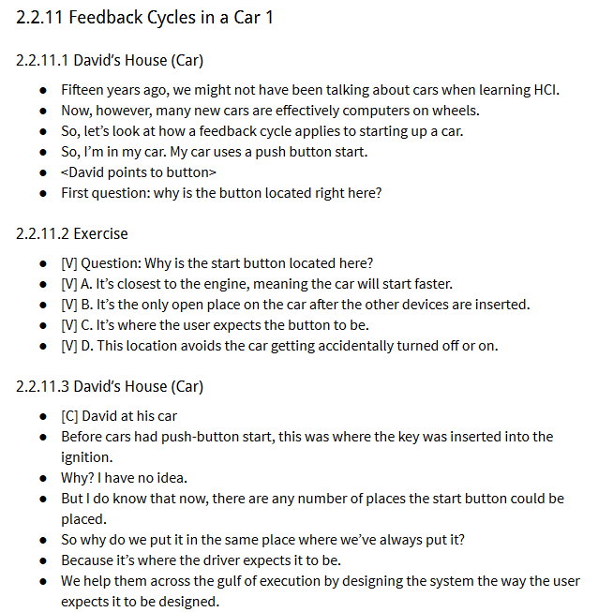

Slide 9
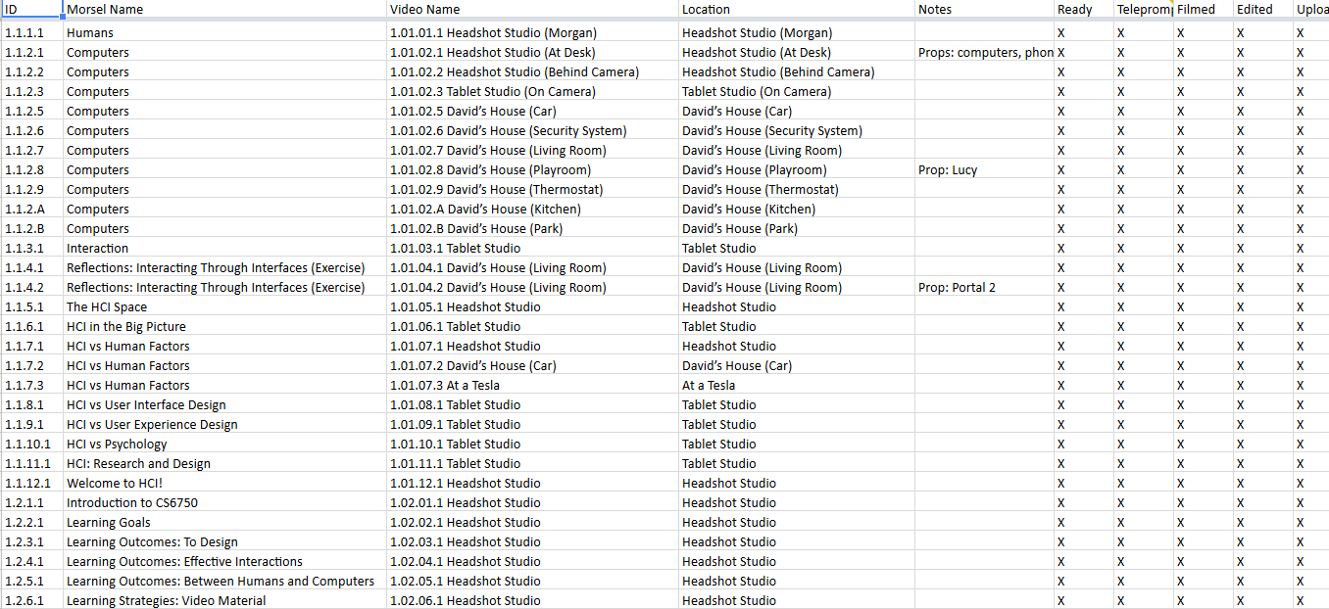

Slide 10
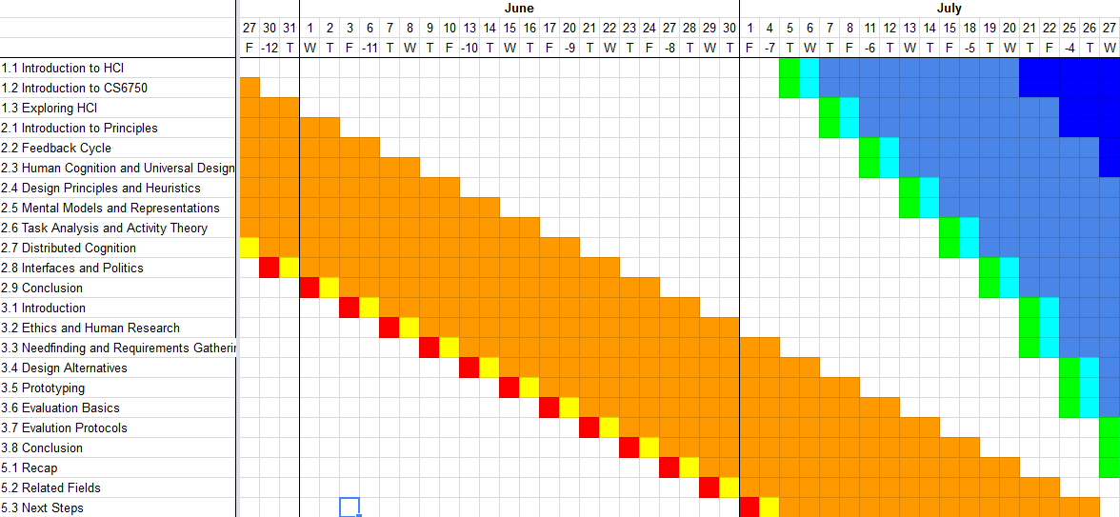

Slide 12
Guideline #1:
Script full course first.

Slide 13
Guideline #2:
Script word-for-word to ensure cohesion when filming out-of-order.

Slide 14
Guideline #3:
Emphasize short videos for maintainability.

Slide 15
Guideline #4:
Leverage short videos for flexibility.

Slide 16
Guideline #5:
Limit dependencies: make each video individually complete.

Slide 17
Guideline #6:
Maintain at the script level, not at the video level.

Slide 18
Guideline #7:
Leverage text for uncertain or untested material.

Slide 19
Questions?
Watch OMS CS6750 at:
bit.ly/omscs6750

